Slide 1

01/12/2025
T.T. Proses ve sürekli iyileştirmenin sağlanması
Sürekli İyileştirme & DMAIC metodologisi / Barış OĞUZ- IASSC SSMBB
https://www.linkedin.com/in/barış-oğuz-4478025a/

Slide 2

Dd/mm/yyyy
MEETING AGENDA
13. Oturum Proje kontrol kapatma
14. Oturum İstatistiksel Proje kontrol ve kapatma
15. Oturum İstatistiksel Proje kontrol ve kapatma
2

Slide 3

3 Gün Programı- Öğleden Önce
Oturum | Konu Başlıkları | Açıklama & Atölye | Başlama | Bitiş
13. Oturum Proje kontrol kapatma | Poka yoke Atölye çalışmasının değerlendirilmesi İPK temel kavramları | ISO 13053 -2 Bilgi Formu 30 | 8:45 | 10:00
Ara | Kahve arası MOLA |  | 10:00 | 10:15
14. Oturum İstatistiksel Proje kontrol ve kapatma | Sürekli verilerin İPK kartları ile incelenmesi | ISO 13053 -2 Bilgi Formu 29 | 10:15 | 11:15
Ara | Kahve arası MOLA |  | 11:15 | 11:30
15. Oturum İstatistiksel Proje kontrol ve kapatma | Ayrık verilerin İPK kartları ile takibi ve izlenmesi Proses yapabilirliği hesaplama | ISO 13053 -2 Bilgi Formu 30 ISO 13053 -2 Bilgi Formu 20 | 11:30 | 12:30
Ara | Öğle Yemeği |  | 12:30 | 13:25

Slide 4
4 Gün Programı- Öğleden sonra
Oturum | Konu Başlıkları | Açıklama & Atölye | Başlama | Bitiş
4. Oturum Veri analizi | Güven aralığı veri analiz yaklaşımı Toplu taşımacılıkta verilerden Şüphe oluşturma Hipotez hazırlama | ISO 13053 -2 Bilgi Formu 09 ISO 13053 -2 Bilgi Formu 24 | 13:30 | 14:30
Ara | Kahve arası MOLA |  | 14:30 | 14:45
5. Oturum Hipotez-Test Veri analizi | Toplu taşımacılıkta verilerin Hipotez testlerle analizi | ISO 13053 -2 Bilgi Formu 25 | 14:45 | 15:45
Ara | Kahve arası MOLA |  | 15:45 | 16:00
6. Oturum ileri Veri Analizi | Toplu taşımacılıkta verilerin Anova analizi Toplu taşımacılıkta verilerin Korelasyon analizi Toplu taşımacılıkta verilerin Basit Regrasyon analizi Toplu taşımacılıkta verilerin Çoklu Regrasyon analizi- |  | 16:00 | 17:00
2. Günün Sonu

Slide 5
Proje kontrol kapatma
1. Oturum
Poka yoke Atölye çalışmasının değerlendirilmesi
İPK temel kavramları
Notes:
Notlar:

Slide 6

Poka-Yoke Nedir? (Temel Tanım ve Amacı)
Amaç: İnsani hataları sistem tasarımıyla önlemek.
Görsel: Metro turnikesine ters girişin engellenmesi örneği.
“Hataları Önlemek, Düzeltmekten Daha Etkilidir”
Hata kaynakları
    Yanlış prosedürden
    Prosesteki aşırı değişkenlikten
    Girdideki aşırı değişkenlikten
    Zayıf tasarımdan
    İnsan hatasından ……...
Notes:
1 min
Trainer Notes: Read the slide, get anything else they would like to add or discuss.

Slide 7

İnsan Hatası Nereden Kaynaklanır?
Hata oluşmasını imkansız kılarak yok etmeye yönelik bir tekniktir.
Hata Önleme Prensipleri :
Çalışanların zekasına ve aklına saygı gösterilmeli.
Sürekli olarak hafızaya veya yoğun dikkate dayalı ve tekrara eden işler için düşünülmeli
Çalışanların daha yaratıcı ve katma değerli faaliyetler zaman ayırmasını sağlayın.
Az sayıda da olsa hata veya hatalı ürün üretmek kesinlikle kabul edilemez.
Amaç sıfır hatadır.
“İlk defada doğru yapmak iyidir: İlk defada yanlış yapmayı imkansız hale getirmek en iyisidir.”
Notes:
2 -3 min
Notes: Cover the content the, emphasize the bottom quote - this is the key definition of Mistake Proofing.

Slide 8



Hata Önleme Teknikleri
Tür | Açıklama | Örnek
Uyarı Tipi | Hata oluşmadan kullanıcıyı uyarır | Düşük lastik basıncı sensörü
Kontrol Tipi | Hata oluşmasını fiziksel olarak engeller | Yanlış fiş takılamayan priz
Zorunlu Sıra Tipi (kapatma) | İşlemlerin doğru sırayla yapılmasını sağlar | Araç bakımında adım kilitleme sistemi
Notes:
3 min
Key Points: 3 Levels of Control Actions, and two timings. With Mistake proofing, there are always choices of ways to reduce or eliminate defects.
Trainer Notes:Cover the 3 levels and 2 timings, examples will follow….focus here is defining the terms.

Slide 9
Hata Önleme Tekniklerinin Güçlü Yanları
Kapatma: hataya acil ve ani müdahale
  Kapatma ile, durdurma veya ara verme şeklinde bir prosesin hataya yol açması veya hatanın geçmesi engellenir.
Kontrol : Hataların proseste bir sonraki aşamaya geçmesine izin verilmez.
  Prosesin veya ürünün yeniden tasarlanması
Uyarı: Proses esnasında hata oluştuğunda tespit ederek anında ikaz vermek.
  Sesli, ışıklı, renkli biçimlerde yapılabilir.
Notes:
2 min
Trainer Notes: Cover the strength of these controls….and the types of issues that may arise…..just further definition.

Slide 10

Bazı Hata Önleme Örnekleri
“Gerçek Hayattan Hata Önleme Örnekleri”
Araç bakımında yanlış yağ türü doldurulmasını önleyen kodlu kapaklar.
Biletleme sisteminde yanlış hat seçimini önleyen dijital yönlendirme ekranları.
Sürücü kabininde kapı kapatılmadan hareket etmeyi önleyen kilitleme sensörü.
Yolcu güvenliğinde durak sensörleri ile kapı aç/kapat kontrolü.
Notes:
7 min
Trainer Notes: Walk through all examples to get the idea clearly across…a testing of the learning will follow…..have fun with this slide.

Slide 11



Çalışma (GRUP)
Son 24 saat içinde karşılaşmış olduğunu en az 3 adet hata önleme metoduna örnek veriniz.
Şoförün varış saatini yanlış okuması
Bakım görevlisinin yanlış parça takması
Yolcunun yanlış perona yönlendirilmesi
Süre 10 dakika
Hata önleme teknikleri
  Temel çalışmalarda
  Kolay ulaşılabilir meyvelerdeki hataları düzeltmek için kullanılabilir.
  Hatayı düzeltmek veya önlemek için acil bir önlem gereken her zaman
Notes:
10 min
Trainer Notes: Have them list these individually, then discuss with those at their tables. Go to each table for one example to share with the class. Discuss the type and make sure it is clear that there are “choices” when mistake proofing - which relate to two things…
Keys to choosing a Mistake Proofing technique:
1. How many of the defects will be eliminated
2. How much will it cost (financial and emotional through change)

Slide 12
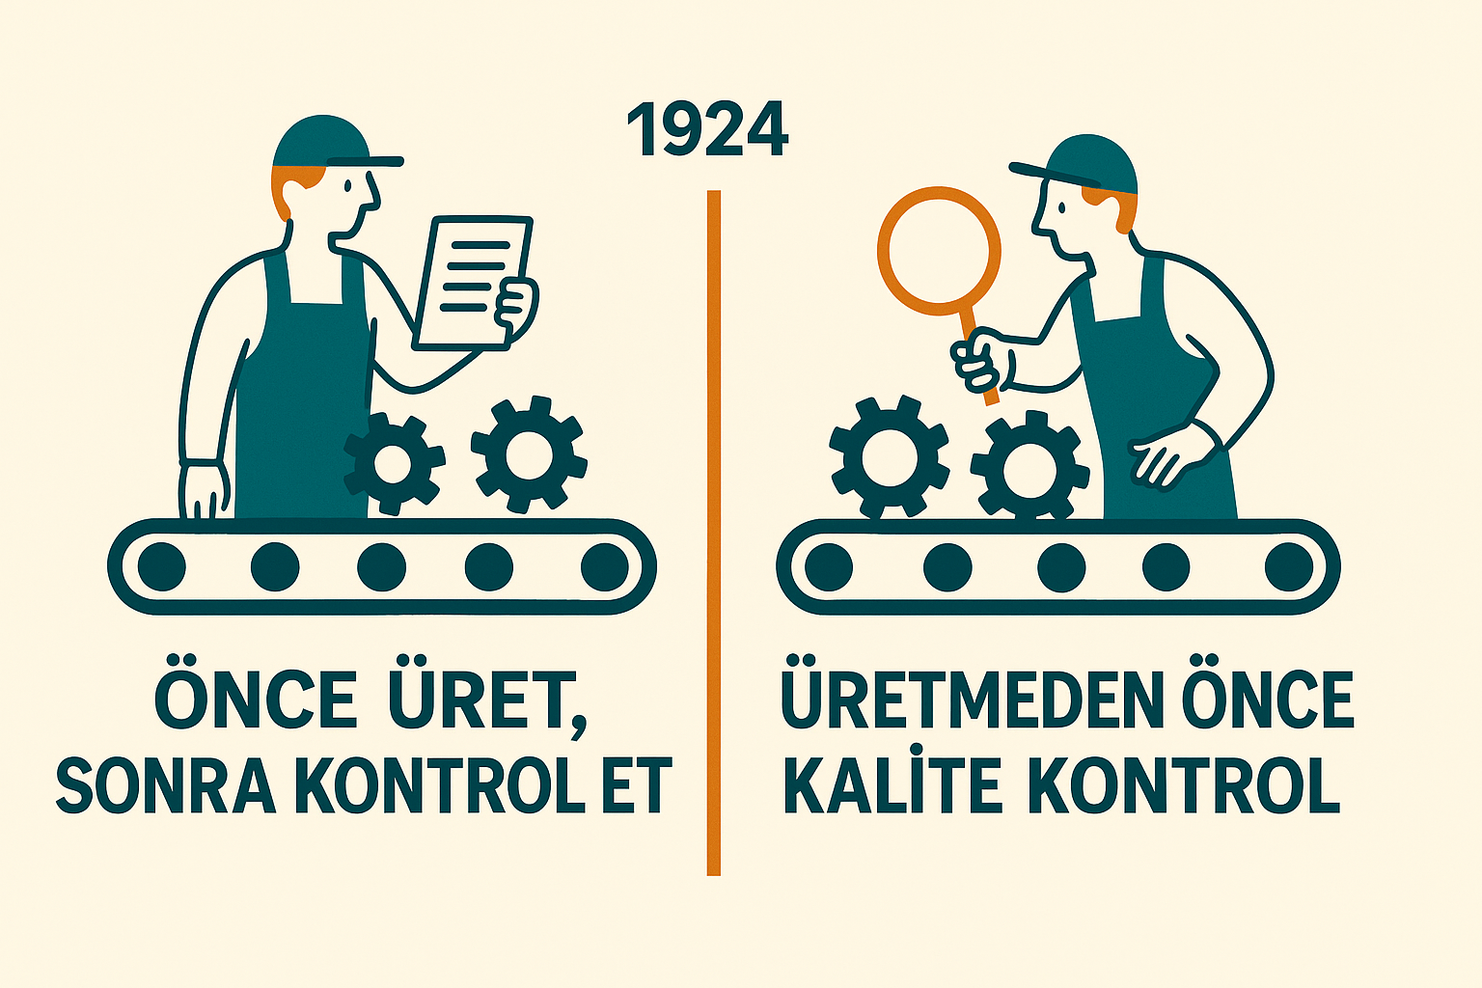


İstatistiksel Proses kontrol (ıpk)
SPC (İstatistiksel Süreç Kontrol), Walter A. Shewhart tarafından 1920'lerin başında Western Electric Company'de (AT&T'nin bir parçası) geliştirilmiş ve ilk kontrol çizelgeleri 1924 yılında kullanılmaya başlanmıştır.
«Telefon sistemleri için üretilen karmaşık donanım ve elektronik parçaların (röleler, anahtarlama ekipmanları vb.) süreçlerindeki varyasyonu kontrol altına almak ve kalitesizlik maliyetlerini düşürmek.»
12
Notes:
Statistical techniques can be used to monitor and manage process performance. Process performance, as we have learned, is determined by the behavior of the inputs acting upon it in the form of Y=f(X). As a result it must be well understood that we can only monitor the performance of a process output. Many people have applied Statistical Process Control (SPC) to only the process outputs. Because they were using SPC, their expectations were high regarding a new potential level of performance and control over their processes. However, because they only applied SPC to the outputs, they were soon disappointed. When you apply SPC techniques to outputs, it is appropriately called Statistical Process Monitoring or SPM.
You of course know that you can only control an output by controlling the inputs that exert an influence on that output. This is not to say that applying SPC techniques to an output is bad, there are valid reasons for doing this. Six Sigma has helped us all to better understand where to apply such control techniques.
In addition to controlling inputs and monitoring outputs, control charts are used to determine the baseline performance of a process, evaluate measurement systems, compare multiple processes, compare processes before and after a change, etc. Control Charts can be used in many situations that relate to process characterization, analysis and performance.
To better understand the role of SPC techniques in Six Sigma, we will first investigate some of the factors that influence processes, then review how simple probability makes SPC work and finally look at various approaches to monitoring and controlling a process.

Slide 13

1. Giriş ve kavramlar
İstatistiksel Proses Kontrolü (SPC), sürecin kararlılığını izler.
Amaç: Varyasyonun nedenlerini belirlemek ve özel nedenleri ortadan kaldırmak.
DMAIC içinde “Control” aşamasının temel aracıdır
Kitle
Örnek
Örnek
Örnek
13
Notes:
Control Charts are usually derived from samples taken from the larger population. Sampling must be collected in such a way that it does not bias or distort the interpretation of the Control Charts. The process must be allowed to operate normally when taking a sample. If there is any special treatment or bias given to the process over the period the data is collected, the Control Chart interpretation will be invalid. The frequency of sampling depends on the volume of activity and the ability to detect trends and patterns in the data. At the onset, you should error on the side of taking extra samples, and then, if the process demonstrates its ability to stay in control you can reduce the sampling rate.
Using rational subgroups is a common way to assure that this does not happen. A rational subgroup is a sample of a process characteristic in which all the items in the sample were produced under very similar conditions and in a relatively short time period. Rational subgroups are usually small in size, typically consisting of 3 to 5 units to make up the sample. It is important that rational subgroups consist of units that were produced as closely as possible to each other, especially if you want to detect patterns, shifts and drifts. If a machine is drilling 30 holes a minute and you wanted to collect a sample of hole sizes, a good rational subgroup would consist of 4 consecutively drilled holes. The selection of rational subgroups enables you to accurately distinguish Special Cause variation from Common Cause variation.
Make sure that your samples are not biased in any way, meaning that they are randomly selected. For example, do not plot only the first shift’s data if you are running multiple shifts. Don’t look at only one vendor’s material if you want to know how the overall process is really running. Finally, don’t concentrate on a specific time to collect your samples; like just before the lunch break.
If your process consists of multiple machines, operators or other process activities that produce streams of the same output characteristic you want to control it would be best to use separate Control Charts for each of the output streams.
If the process is stable and in control, the sample observations will be randomly distributed around the average. Observations will not show any trends or shifts and will not have any significant outliers from the random distribution around the average. This type of behavior is to be expected from a normally operating process and that is why it is called Common Cause variation. Unless you are intentionally trying to optimize the performance of a process to reduce variation or change the average, as in a typical Six Sigma project, you should not make any adjustments or alterations to the process if is it demonstrating only Common Cause variation. That can be a big time saver since it prevents “wild goose chases.”
If Special Cause variation occurs, you must investigate what created it and find a way to prevent it from happening again. Some form of action is always required to make a correction and to prevent future occurrences.
You may have noticed there has been no mention of the specification limits for the characteristic that is being controlled. Specification limits are not evaluated when using a Control Chart. A process in control does not necessarily mean it is capable of meeting the requirements. It only states that it is stable, consistent and predictable. The ability to meet requirements is called Process Capability, as previously discussed.

Slide 14

Neden Proses Kontrolü?
Hataları önceden fark etmek, düzeltme maliyetlerini düşürür.
Süreçlerin kararlılığını ve öngörülebilirliğini artırır.
Kaliteyi garanti altına almak için veriyle yönetim
14
Notes:
Individual Values (I) and Moving Range (MR) Charts are used when each measurement represents one batch. The subgroup size is equal to one when I-MR charts are used. These charts are very simple to prepare and use. The graphic shows the Individuals Chart where the individual measurement values are plotted with the Center Line being the average of the individual measurements. The Moving Range Chart shows the range between two subsequent measurements.
There are certain situations when opportunities to collect data are limited or when grouping the data into subgroups simply doesn't make practical sense. Perhaps the most obvious of these cases is when each individual measurement is already a rational subgroup. This might happen when each measurement represents one batch, when the measurements are widely spaced in time or when only one measurement is available in evaluating the process. Such situations include destructive testing, inventory turns, monthly revenue figures and chemical tests of a characteristic in a large container of material. All of these situations indicate a subgroup size of one. Because this chart is dealing with individual measurements it, is not as sensitive as the X-Bar Chart in detecting process changes.

Slide 15

Temel Kavramlar
Proses, varyasyon, spesifikasyon limitleri, kontrol limitleri. UCL – CL – LCL kavramları.
Alt grup örnek büyüklüğü n?
“Proses kararlı mı?” sorusuna yanıt arar.
Lot 1
Lot 5
Lot 3
Lot 2
Alt grup
Lot 4
Toplam çalışma alanı
15
Notes:
An Xbar-R is used primarily to monitor and control the stability of the average value. The Xbar Chart plots the average values of each of a number of small sampled subgroups. The averages of the process subgroups are collected in sequential, or chronological, order from the process. The Xbar Chart, together with the Rbar Chart shown, is a sensitive method to identify assignable causes of product and process variation, and gives great insight into short-term variations.
These charts are most effective when they are used together as a matched pair. Each chart individually shows only a portion of the information concerning the process characteristic. The upper chart shows how the process average (central tendency) changes. The lower chart shows how the variation of the process has changed.
It is important to control both the process average and the variation separately because different corrective or improvement actions are usually required to effect a change in each of these two parameters.
The Rbar Chart must be in control in order to interpret the averages chart because the Control Limits are calculated considering both process variation and center. When the Rbar Chart is not in control, the Control Limits on the averages chart will be inaccurate and may falsely indicate an out of control condition. In this case, the lack of control will be due to unstable variation rather than actual changes in the averages.
Xbar and Rbar Charts are often more sensitive than I-MR, but are frequently done incorrectly. The most common error is failure to perform rational sub-grouping correctly.
A rational subgroup is simply a group of items made under conditions that are as nearly identical as possible. Five consecutive items, made on the same machine, with the same setup, the same raw materials, and the same operator, are a rational subgroup. Five items made at the same time on different machines are not a rational subgroup. Failure to form rational subgroups correctly will make your Xbar-Rbar Charts dangerously wrong.

Slide 16
Varyasyon Türleri
Doğal nedenli varyasyon (Genel): Sürecin içsel değişkenliği.
Özel nedenli varyasyon (Özel): Dış etken veya hata kaynaklı sapmalar.bu sapmalar limit dışında olabileceği gibi limit içinde de olabilir.
Üst üste 14 kez gözlem değerlerinin bir aşağı bir yukarı olması !...
Toplu taşımada örnek: “Yoğun saatlerde gecikme.”
Özel sebep
Proses ortalaması
Genel sebep
16
Notes:
The U Chart plots defects per unit data collected from subgroups of equal or unequal sizes. The “U” in U Charts stands for defects per Unit. U Charts plot the proportion of defects that are occurring.
The U Chart and the C Chart are very similar. They both are looking at defects, but the U Chart does not need a constant sample size like the sample size like the C Chart. The Control Limits on the U Chart vary with the sample size and therefore they are not uniform, similar to the P Chart which we will describe next.
Counting defects on forms is a common use for the U Chart. For example, defects on insurance claim forms are a problem for hospitals. Every claim form has to be checked and corrected before going to the insurance company. When completing a claim form, a particular hospital must fill in 13 fields to indicate the patient’s name, social security number, DRG codes and other pertinent data. A blank or incorrect field is a defect.
A hospital measured their invoicing performance by calculating the number of defects per unit for each day’s processing of claims forms. The graph demonstrates their performance on a U Chart.
The general procedure for U Charts is as follows:
1. Determine purpose of the chart
2. Select data collection point
3. Establish basis for sub-grouping
4. Establish sampling interval and determine sample size
5. Set up forms for recording and charting data and write specific instructions on use of the chart
6. Collect and record data.
7. Count the number of nonconformities for each of the subgroups
8. Input into Excel or other statistical software.
9. Interpret chart together with other pertinent sources of information on the process and take corrective action if necessary

Slide 17



Proses hatalarını tanıyalım
Merkezden kayma
Varyasyon (değişim)
Takip edilen proseste
Veri bir yöne ve eşit hata yapması durumudur.
Basit takılmalar, Mekanik, Ölçümsel, Malzeme, Standart (metod) ilgili durumlardır.
Takip edilen proseste
Veri bir yöne ve eşit olmayan gelişi güzel sonuçlar üretmesi durumudur.
Sebepi net olmayan kompleks durumlardır,
Standart olmayan, insan çevre gibi kontrolü zor değişkenlerin sebep olduğu durumlar olabilir.
17
Notes:
Control Charts were first developed by Dr. Shewhart in the early 20th century in the U.S. Control Charts are a graphical and visual plot of a process and is charted over time like a Time Series Chart. From a visual management aspect, a Time Plot is more powerful than knowledge of the last measurement. These charts are meant to indicate change in a process. All SPC charts have a Central Line and Control Limits to aid in Special Cause variation.
Notice, again, we never discussed showing or considering specifications. We are advising you to never have specification limits on a Control Chart because of the confusion often generated. Remember we want to control and maintain the process in the newly improved process based on the recently improved past. These Control Charts and their limits are the Voice of the Process not the Voice of the Customer which are the specification limits.

Slide 18

İstatistiksel proses kontrol başlatma
Grafiği oluşturulacak karakteristiği (kritik "X" veya CTQ) seçin.
Grafiğin amacını belirleyin.
Veri toplama noktalarını seçin.
Alt gruplama için temel oluşturun (yalnızca Y'ler için).
Kontrol Grafiği türünü seçin.
Ölçme yöntemini/kriterlerini belirleyin.
Örnekleme aralığını/frekansını belirleyin.
Örneklem büyüklüğünü belirleyin.
Kontrol Limitlerinin hesaplanmasının temelini oluşturun.
Grafik verileri için formları veya yazılımı kurun.
Veri toplamak için formları veya yazılımı ayarlayın.
Tüm aşamalar için yazılı talimatlar hazırlayın.
Gerekli eğitimi yapın.
18
Notes:
Please read the slide.

Slide 19
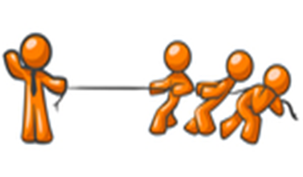

En çok kullanılan ipk kartları
Kontrol kart seçimi
Choose Appropriate Control Chart
Data tipi
type
of data
Sürekli veri
Ayrık Veri
CONTINUOUS
ATTRIBUTE
Ayrık data
type of
attribute
data
Alt grup
büyüklüğü
subgroup
size
Üründeki hata
DEFECTS
Hatalı ürün
DEFECTIVES
Sample size
Sample size
1
1
2-5
2-5
10+
Hata türü
10+
type
of defect
Alt grup tipi
type of
subgroups
I – MR Chart
I – MR Chart
X – R Chart
X – R Chart
X – S Chart
X – S Chart
Sabit
CONSTANT
Değişken
Sabit
VARIABLE
CONSTANT
Değişken
VARIABLE
Individuals & Moving Range
Individuals & Moving Range
Mean & Range
Mean & Range
Mean & Std. Dev.
Mean & Std. Dev.
C Chart
C Chart
U Chart
U Chart
NP Chart
NP Chart
P Chart
P Chart
Özel Durumlar
SPECIAL CASES
Number of Incidences
Number of Incidences
Incidences per Unit
Incidences per Unit
Number of Defectives
Number of Defectives
Proportion Defectives
Proportion Defectives
CumSum Chart
CumSum Chart
EWMA
Chart
EWMA
Chart
Cumulative Sum
Cumulative Sum
Exponentially Weighted Moving Average
Exponentially Weighted Moving Average
19
Notes:
The Control Charts you choose to use will always be based first on the type of data you have and then on the objective of the Control Chart. The first selection criteria will be whether you have Attribute or Continuous Data.
Continuous SPC refers to Control Charts that display process input or output characteristics based on Continuous Data - data where decimal subdivisions have meaning. When these Control Charts are used to control the Critical X input characteristic it is called Statistical Process Control (SPC). These charts can also be used to monitor the CTQ’s, the important process outputs. When this is done it is referred to as Statistical Process Monitoring (SPM).
There are two categories of Control Charts for Continuous Data: charts for controlling the process average and charts for controlling the process variation. Generally, the two categories are combined. The principal types of Control Charts used in Six Sigma are: charts for Individual Values and Moving Ranges (I-MR), charts for Averages and Ranges (XBar-R), charts for Averages and Standard Deviations (XBar-S) and Exponentially Weighted Moving Average charts (EWMA).
Although it is preferable to monitor and control products, services and supporting processes with Continuous Data, there will be times when Continuous Data is not available or there is a need to measure and control processes with higher level metrics, such as defects per unit. There are many examples where process measurements are in the form of Attribute Data. Fortunately, there are control tools that can be used to monitor these characteristics and to control the critical process inputs and outputs that are measured with Attribute Data.
Attribute Data, also called discrete data, reflects only one of two conditions: conforming or nonconforming, pass or fail, go or no go, present or absent. Four principal types of Control Charts are used to monitor and control characteristics measured in Attribute Data: the P (proportion nonconforming), NP (number nonconforming), C (number of non-conformities) and U (non-conformities per unit) Charts. Four principle types of Control Charts are used to monitor and control characteristics measured in Discrete Data: the P (proportion nonconforming), NP (number nonconforming), C (number of non-conformities) and U (non-conformities per unit) Charts. These charts are an aid for decision making. With Control Limits, they can help us filter out the probable noise by adequately reflecting the Voice of the Process.
A defective is defined as an entire unit, whether it be a product or service, that fails to meet acceptance criteria, regardless of the number of defects in the unit. A defect is defined as the failure to meet any one of the many acceptance criteria. Any unit with at least one defect may be considered to be a defective (Sometimes more than one defect is allowed, up to some maximum number, before the product is considered to be defective).

Slide 20



15 dakika ARA
COFFEE?

Slide 21

2. Oturum
Sürekli verilerin İPK kartları ile incelenmesi
İstatistiksel Proje kontrol ve kapatma

Slide 22
2- Sürekli veriler için İPK Xbar-R
Smarttrans’a ait 150 vagon her gün hizmete başlamadan önce kontrol ve bakımları temizlik ve bakım grubuna bağlı personel tarafından yapılmakta. Temizlik ve bakım sürecinde temizlik süresi (Y)’nin iyileştirilmesi ve oluşabilecek anormalliklerin önüne geçmek için şef İPK kartı uygulaması yapmak istiyor
Grafiği oluşturulacak karakteristiği (kritik "X" veya CTQ) seçin.
Grafiğin amacını belirleyin.
Veri toplama noktalarını seçin.
Alt gruplama için temel oluşturun (yalnızca Y'ler için).
Kontrol Grafiği türünü seçin.
Ölçme yöntemini/kriterlerini belirleyin.
Örnekleme aralığını/frekansını belirleyin.
Örneklem büyüklüğünü belirleyin.
Kontrol Limitlerinin hesaplanmasının temelini oluşturun.
Grafik verileri için formları veya yazılımı kurun.
Veri toplamak için formları veya yazılımı ayarlayın.
Tüm aşamalar için yazılı talimatlar hazırlayın.
Gerekli eğitimi yapın.
Vagon bakım temizlik süresi
Temizlik ssürelerinin iyileştirilmesi
Her sabah ekip temizlik bakım takip formu
5 adet vagon
Xbar R Kontrol Grafiği
Temizlik bakım takip formu
Günlük 5 araç
5 Araç .
Kontrol Limitlerinin hesaplanmasının temelini oluşturun.
22

Slide 23
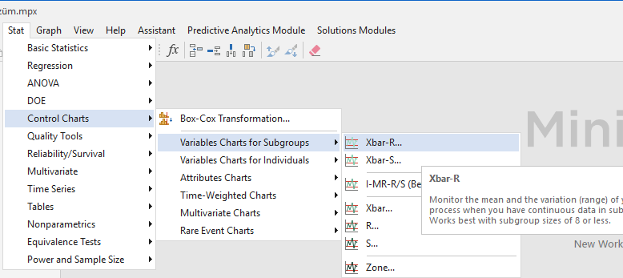
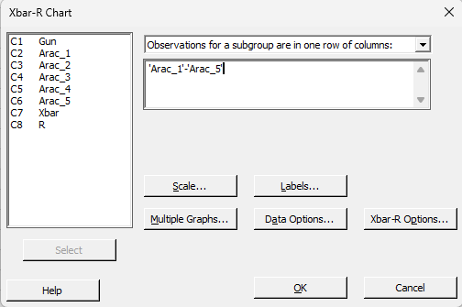
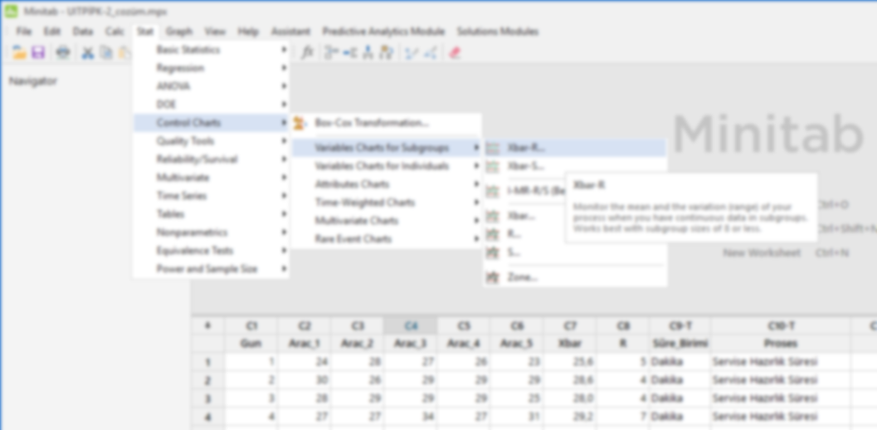




Sürekli veriler için IPK Xbar-R
9. Kontrol Limitlerinin hesaplanmasının temelini oluşturun.

Slide 24
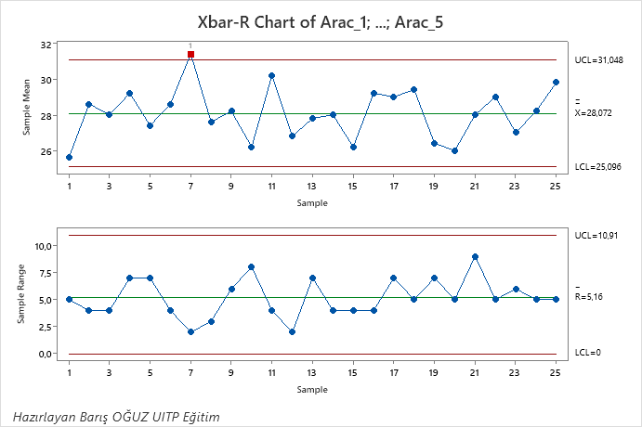






Xbar-R grafiğinin yorumlanması
9 Adım da takip etmek istediğimiz prosesin kontrol limitlerinin belirlenir.
Bu örnekte ;
UKL $=31,$048
Veriler göstermektedir ki Araç temizleme ortalama süresi 28,072dk sürmekte,
Proses takip edilmeli
$$\overline{x}=28,072$$
AKL $=25,096$
UKL = 10,91
$$\overline{R}=5,16$$
AKL $=$ 0,00
24

Slide 25

Sürekli veriler için İPK I-MR
Aynı otobüs (örneğin “ARAÇ 27”)
Aynı hat (örneğin Hat 7 – Merkez Terminal – Kampüs)
Her gün 10 tur atıyor (ya da 30 ardışık tur ölçümü alınabilir).
Ölçüm: Her turun süresi (dakika cinsinden).
Beklenen ortalama: 42 dk
Doğal varyasyon: ±3 dk
Amaç: Hat performansının kararlı olup olmadığını görmek.
25

Slide 26
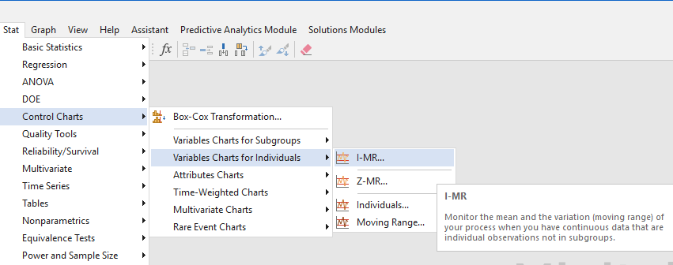
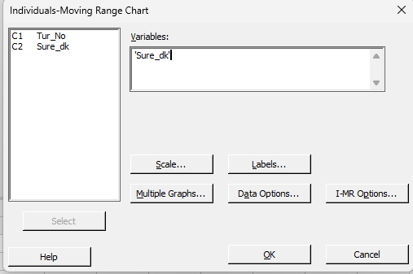
Sürekli veriler için IPK
9. Kontrol Limitlerinin hesaplanmasının temelini oluşturun.

Slide 27
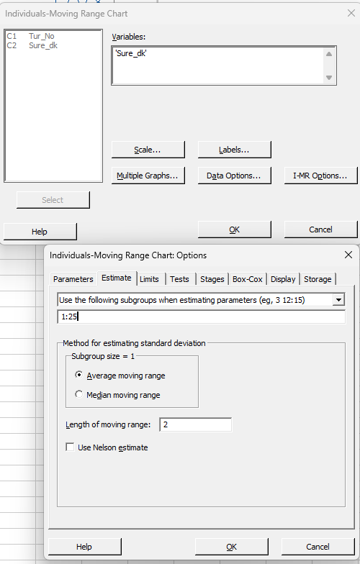
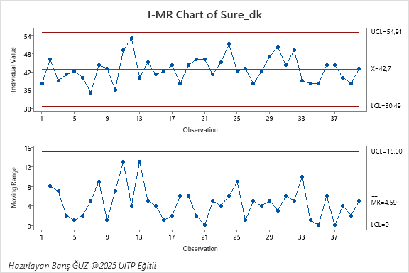






I-MR grafiğinin yorumlanması
9 Adım da takip etmek istediğimiz prosesin kontrol limitlerinin belirlenir.
UKL $=54,91$
$$\overline{x}=42,7$$
AKL $=30,49$
UKL = 15,00
$$\overline{R}=4,59$$
AKL $=$ 0,00
Kontrol limitlerini belirleyip sonraki verilerin bu limitler tarafından değerlendirilmesi için
27

Slide 28
15 dakika ARA
COFFEE?
28

Slide 29
3. Oturum
Ayrıki verilerin İPK kartları ile incelenmesi
Kontrol ve kapama
İstatistiksel Proje kontrol ve kapatma
29

Slide 30

3 Sürekli veriler için İPK P grafiği
Smarttrans’a artan kaçak yolcu sayısını takip ve iyileştirmek için İPK çalışması başlattı.
Toplam ölçüm: 100 satır
Hatlar: 5 hat (HatA, HatB = Uzun; HatC = Orta; HatD, HatE = Kısa)
Her hat için: 20 ölçüm (her ölçüm saatlik geçen yolcu sayısı örneği)
Alanlar (sütunlar):
MeasurementID — Ölçüm kimliği
Line — Hat adı
Distance — Hat türü (Uzun/Orta/Kısa)
Entries — Bir saatte turnikelerden geçen binen yolcu sayısı
Exits — Bir saatte turnikelerden çıkan yolcu sayısı (Entries'den her zaman daha fazla, kullanıcı talebine göre)
Evaders — Exits - Entries (kaçak yolcu sayısı)
EvasionRate — Evaders / Entries
30

Slide 31
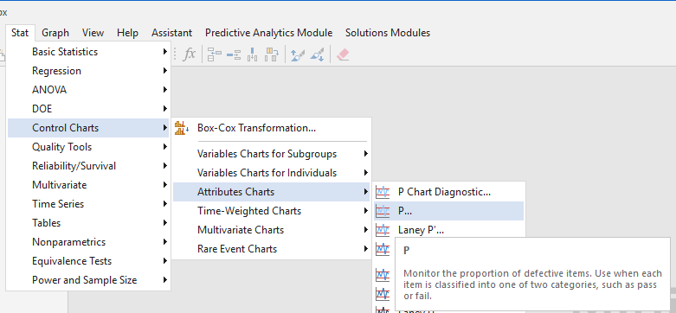
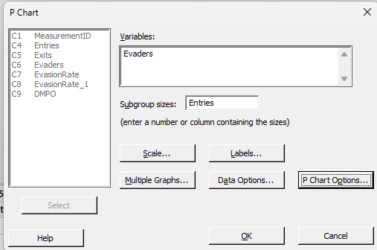
Sürekli veriler için IPK I-MR
9. Kontrol Limitlerinin hesaplanmasının temelini oluşturun.

Slide 32
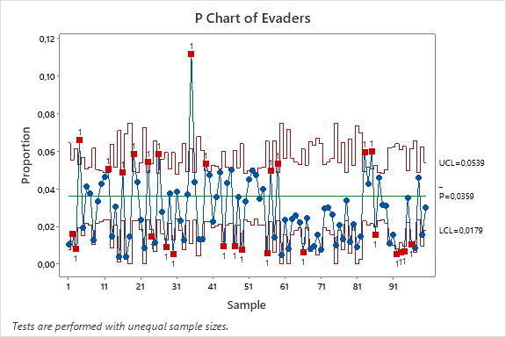
P grafiğini yorumlanması
9 Adım da takip etmek istediğimiz prosesin kontrol limitlerinin belirlenir.
Veriler göstermektedir ki her 10.000 yolcudan 359 tanesine ücretsiz seyahat etmekte bu tüm hatların ortalamasıdır.
Bu standart diğer hatlar ile karşılaştırılabilir veya bu konudaki diğer dünya normları ile kıyaslanabilir.
Bu noktada bu değer norm olarak belirlenebilir ve takip edilebilir limit
32

Slide 33
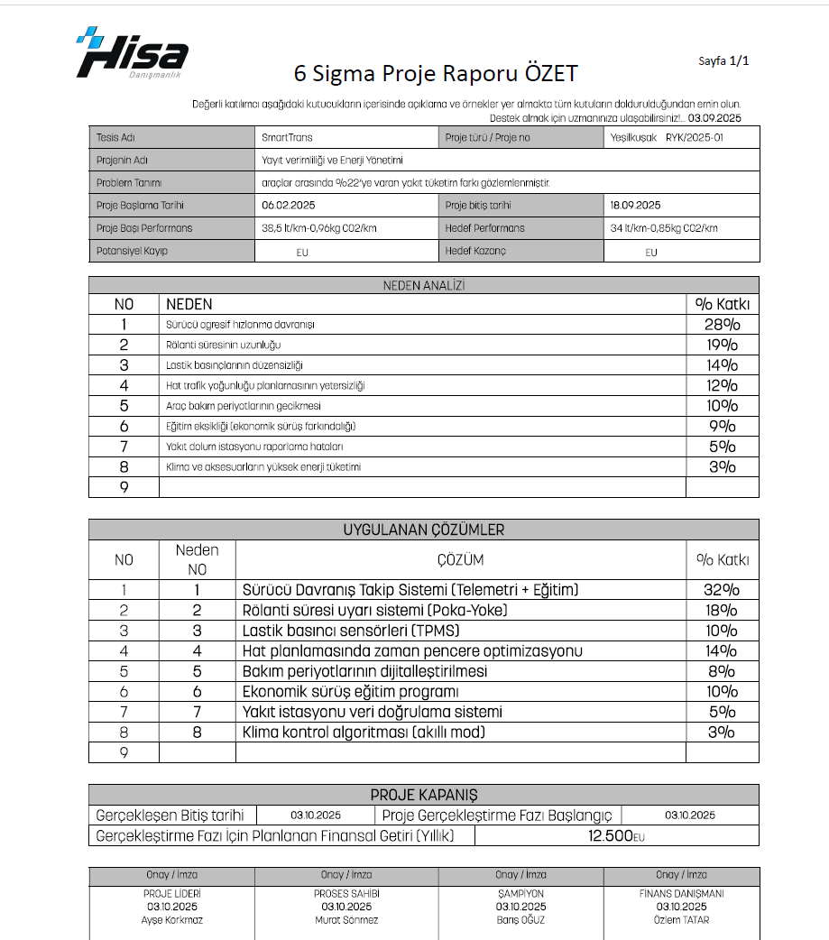
Kontrol ve kapatma Form 30
33

Slide 34

1. Kontrol Planı (Control Plan)
Amaç: Sürecin iyileştirme sonrası nasıl izleneceğini tanımlamak.
İçerik:
  CTQ parametreleri nasıl ölçülür?
  Kim, ne sıklıkla kontrol eder?
  Limit dışı durumda hangi aksiyon alınır?
Araç: Form 30
34

Slide 35
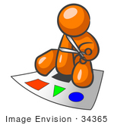
2. Dokümantasyon ve Standartlaştırma (Standardization)
İyileştirme sonrası yeni yöntemlerin SOP (Standard Operating Procedure) haline getirilmesi.
Görsel iş talimatları, kontrol listeleri, hat içi görseller.
5S – Görsel Yönetim uygulamalarıyla bağlantı kurulabilir.
Örnek: “Servise hazırlık süreci yeni kontrol listesi” görseli.
35

Slide 36

3. Eğitim ve Yetkinlik Planı
Yeni standartların yayılımı için operatör, bakım, sürücü, kalite personeli eğitim planı.
Eğitim doğrulama formları (Before/After testi).
Poka-Yoke örneklerinin saha eğitimlerinde kullanılmasına değinilebilir.
36

Slide 37

4. Süreç İzleme Göstergeleri (Process Monitoring)
KPI (Key Performance Indicator) – örnek:
  “Zamanında Varış %”,
  “Servise Hazırlık Süresi Ortalaması”,
  “Kaçak Yolcu Oranı”,
  “Arıza Başına Ortalama Süre”.
Her KPI için:
  Hedef değeri,
  İzin verilen varyasyon,
  Raporlama sıklığı.
37

Slide 38

5. Kontrol Fazı Denetimleri (Layered Process Audit / LPA)
6 Sigma projelerinde kalıcılığı sağlamak için çok katmanlı denetim (LPA) sisteminin tanıtımı.
Katman 1: Operatör günlük kontrolü
Katman 2: Hat şefi haftalık kontrolü
Katman 3: Yönetim aylık gözden geçirme
İyileştirme sonrası “geri kaymayı” önler.
İyileştirme sonrası sağlanan kazançların (tasarruf, kalite, memnuniyet) düzenli izlenmesi.
3–6–12 aylık kontrol gözden geçirmeleri.
“Control Phase Closure” formatı — Form-30 güncellemesiyle bağlanabilir.
38

Slide 39


Öğle yemeği
4. Oturum
13:25 de başlayacak
Afşyet olsun

Slide 40

QUESTIONS?
2. Günün Sonu

Slide 41



THANK YOU!
baris@hisakalite.com
https://www.linkedin.com/in/baris-oguz-4478025a/
www.hisa.tr

